Slide 1
ANOVA and Kruskal-Wallis
a Monte Carlo power study
By Vaughn Hajra and Luis Weekes

Slide 2
Roadmap
Motivation for why we chose this project
Power Study with normal distribution
Power Study with nonconstant variance
1
3
5
2
4
6
Introduction of ANOVA and Kruskal-Wallis tests
Power Study with Cauchy distribution
Takeaways and conclusions

Slide 3
1. Motivation and Background
What are our goals with this power study?
Why do we want to study this?

Slide 4
Non-parametric vs Parametric Statistics
Parametric procedures assume that sample data can be represented by a probability distribution with fixed parameters.
Nonparametric procedures does not assume an explicit distribution.
Use nonparametric procedures when the underlying distributions are not known and when there might be potential outliers.

Slide 5
When to Use What Test?
What is Power?
Real world scenarios vary.
Power of a study changes based on characteristics of study.
Power lets us know which study is better overall in a specific scenario.
Probability of rejecting the null hypothesis when it is in fact incorrect.

Slide 6
2. Introduction of Tests
ANOVA
Kruskal-Wallis

Slide 7
What do ANOVA and Kruskal-Wallis test for?
They test whether at least one mean/median is different from the rest (in a group).

Slide 8
Conditions for One-Way ANOVA
Normality
To run a one way ANOVA test, the data must be normally distributed
Homoscedasticity
Equal variances for the groups being compared
(We often use SDs to check this)
Independence
The observations must be independent between and within groups

Slide 9
Conditions for Kruskal-Wallis
Continuous Distribution
Although normality is no longer required, a continuous distribution is required.
Similar Distribution Shapes
Similar distributions from group to group required.
Independence
The observations must be independent between and within groups

Slide 10
One Way ANOVA: Basketball Conferences
Addressing the question:
“Do certain conferences perform better than others?”

Slide 11
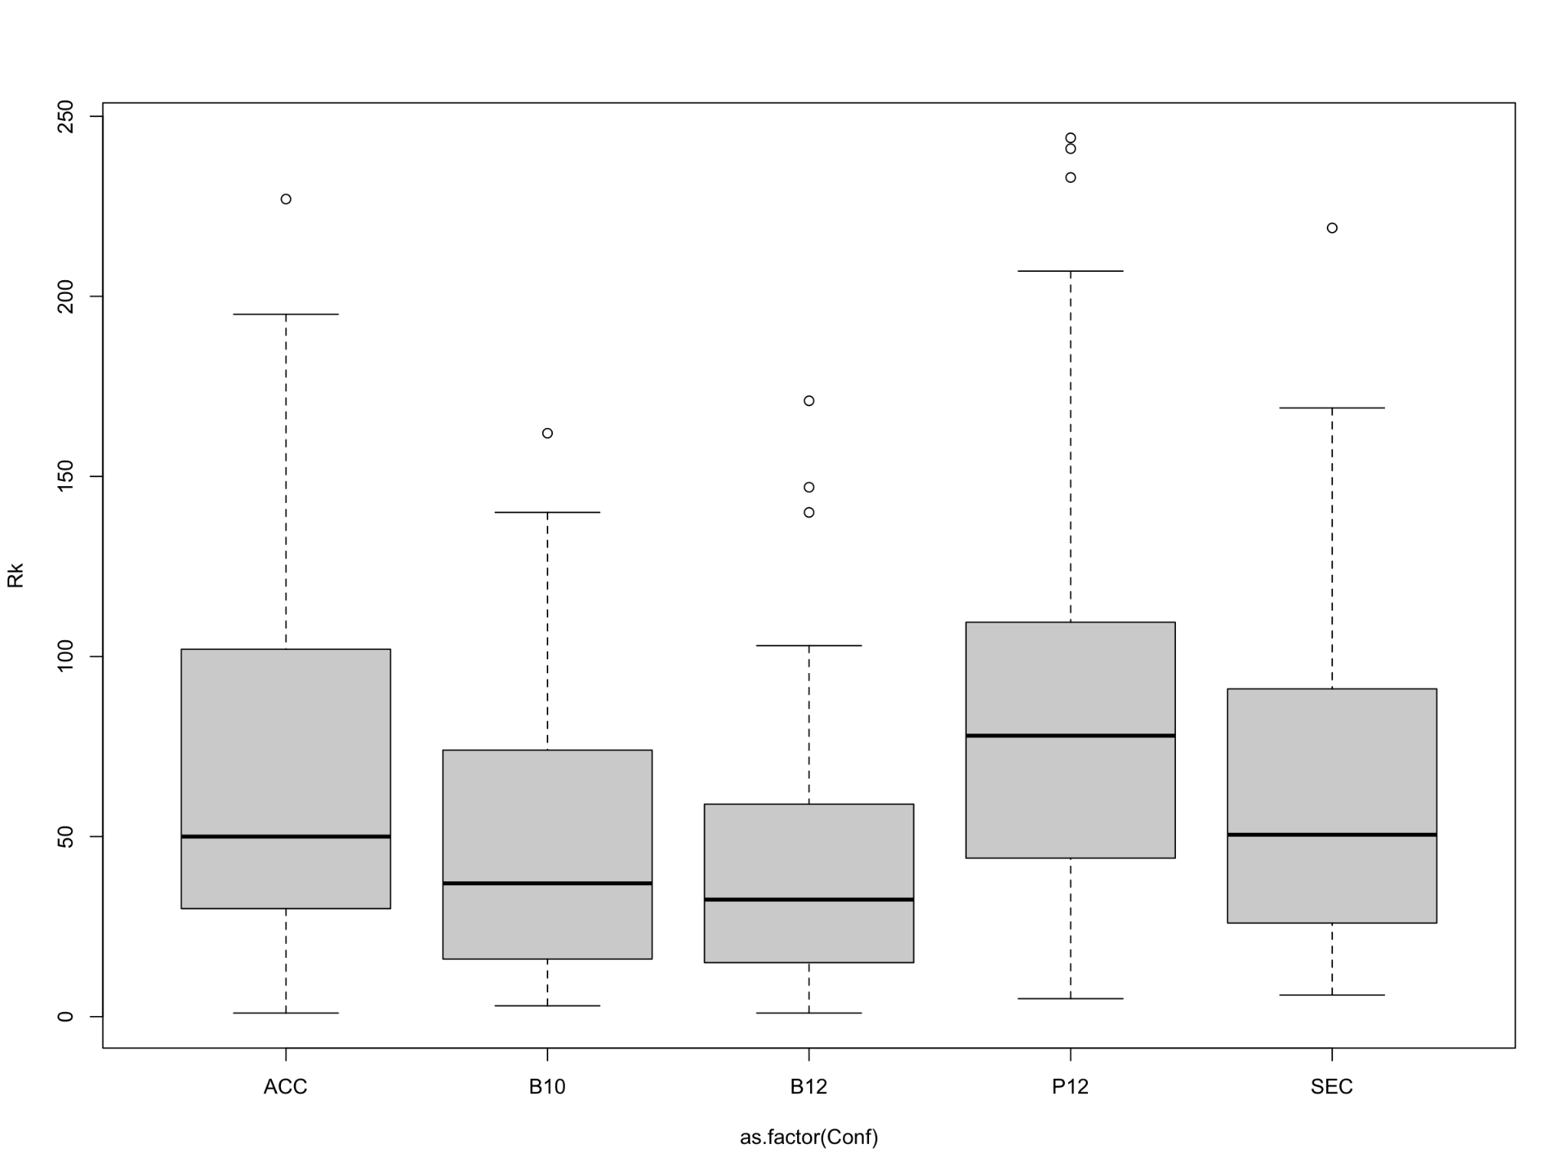
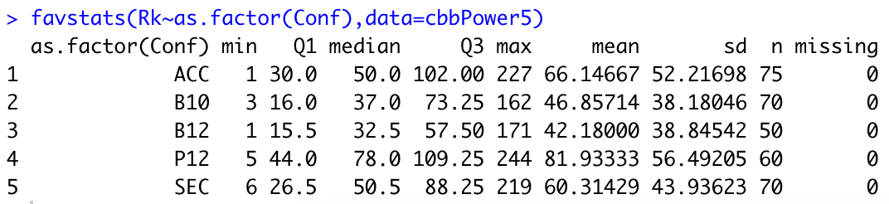
Exploratory Data Analysis
Data Background:
Dataset summary statistics
Box plots

Slide 12

One-Way ANOVA Model
Where Refers to the conference effect.

Slide 13
One-Way ANOVA Hypothesis
Ho: There is no difference in the mean KenPom ranks for each conference:
µ1 = µ2 = µ3 = µ4 = µ5
Ha: One or more of the conferences are different in their mean rank:
µi ≠ µj

Slide 14
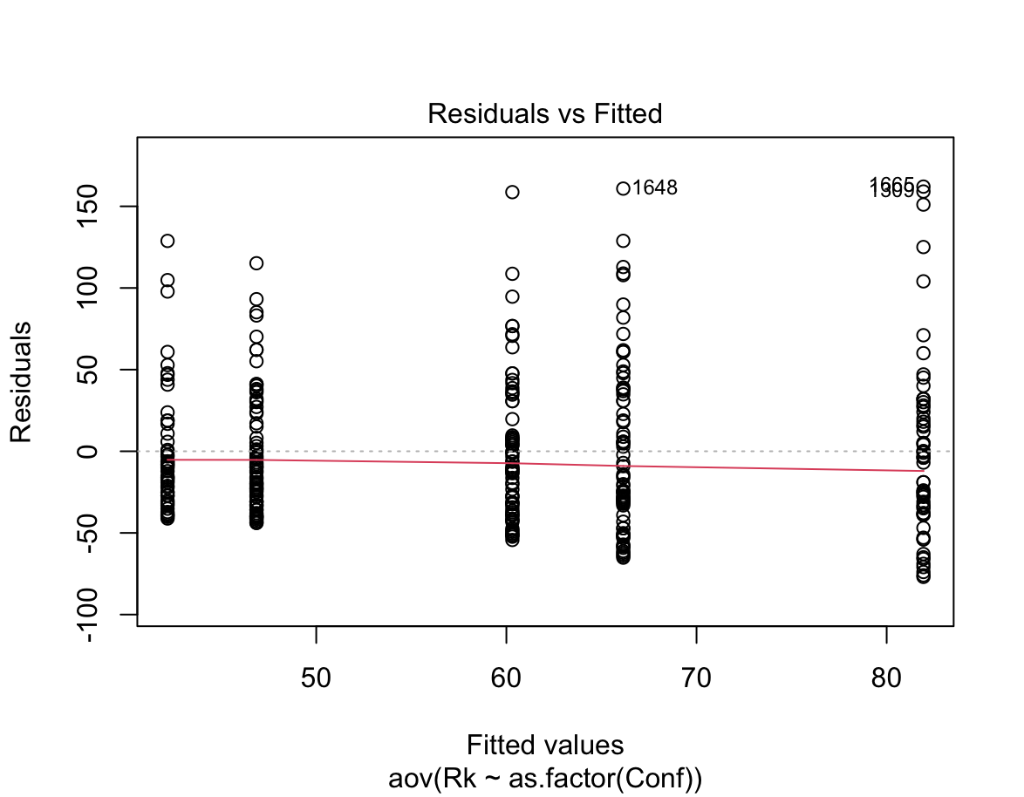
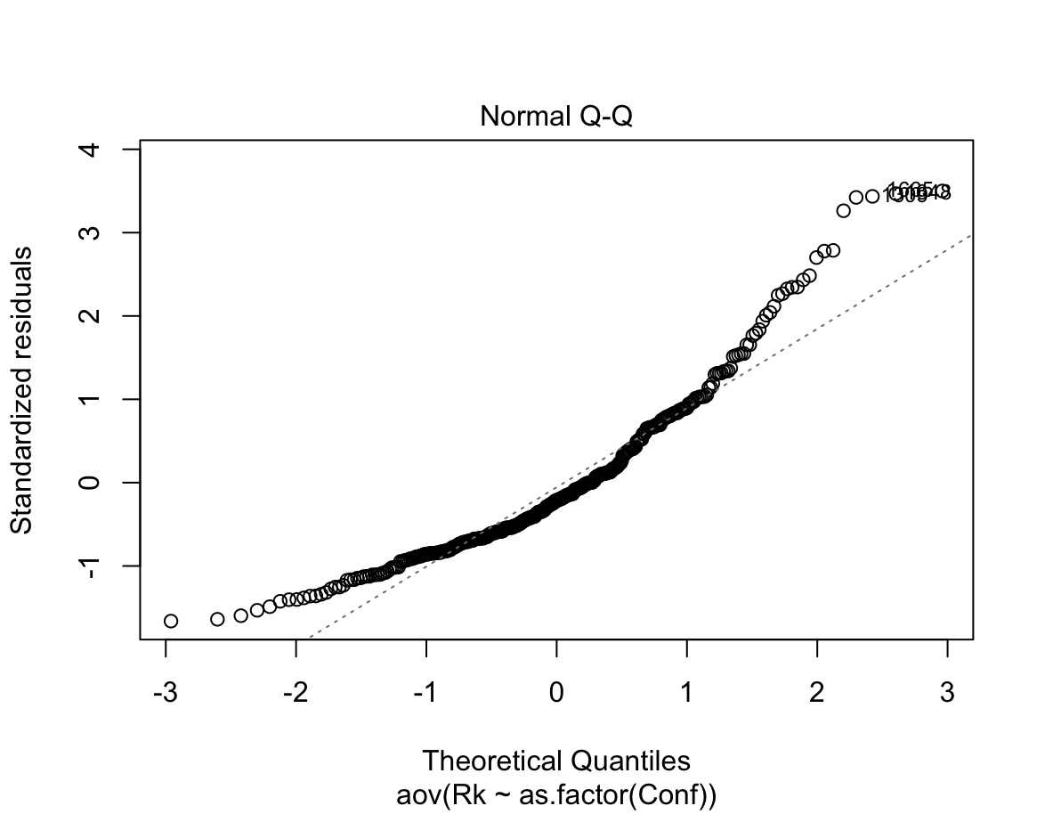
One-Way Conditions

Slide 15
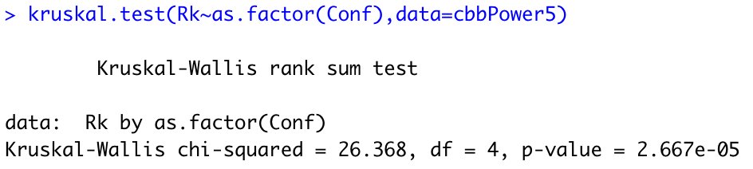
Kruskal-Wallis Test

Slide 16
3. Power Studies
Normal Distribution
Cauchy Distribution
Different Sample Sizes
Non-Constant Variance

Slide 17
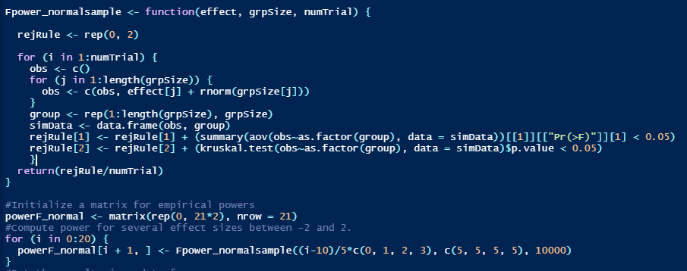
Monte Carlo Simulation
(0,1,2,3) -> observe the theoretical means all differ from one another

Slide 18
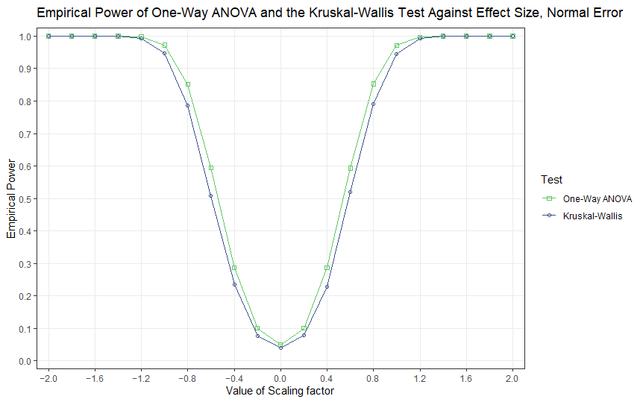
Samples Taken From a Normal Distribution

Slide 19
What does this mean?
When error term follows the normal distribution, one-way ANOVA performs better than Kruskal-Wallis
Note the values of alpha (probability of type 1 error)
Using large sample approximation because code for actual test takes so long

Slide 20
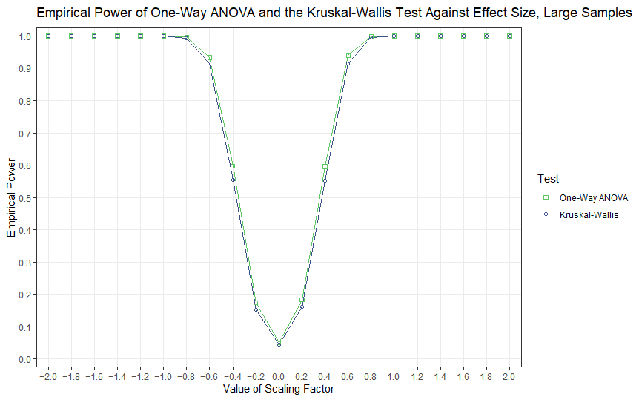
Power when Sample Size is Doubled

Slide 21
What does this mean?
Now we see that the power of the Kruskal-Wallis test is much closer to the one way ANOVA test
Still prefer ANOVA, but powers for both tests go up faster as we increase the size of the scaling factor

Slide 22
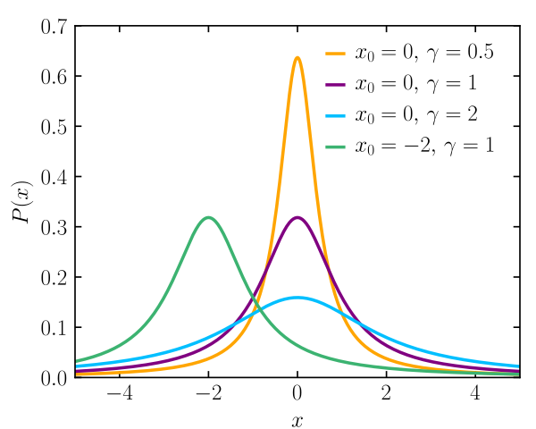
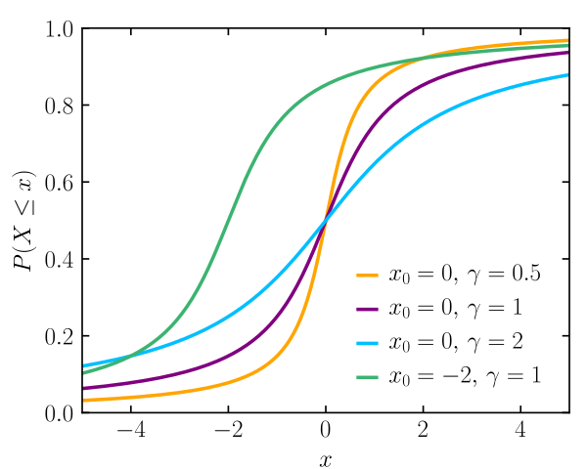
What is the Cauchy Distribution?
Takes two parameters, x₀ and 𝜸
Can be centered around different x₀ values
Continuous distribution (heavier tails than normal)
Due to heavy tails, we want to compare power of both tests using this distribution.
Probability Density Function
Cumulative Distribution Function
Graphs via Wikipedia - https://en.wikipedia.org/wiki/Cauchy_distribution

Slide 23
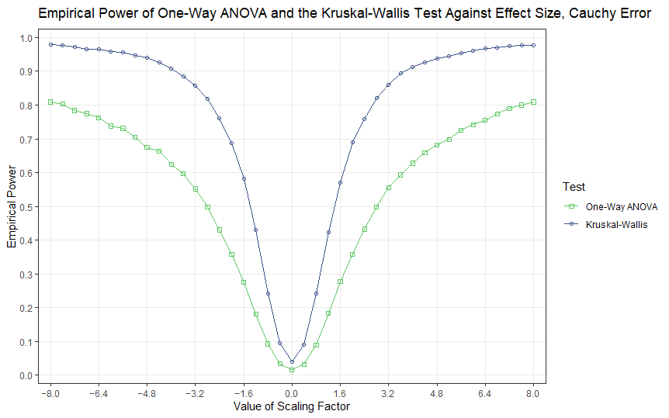

Samples Taken From a Cauchy Distribution
Adjusted Code! ->

Slide 24
What does this mean?
When there are a lot of outliers in the data, the Kruskal-Wallis test performs better than ANOVA.
(Note special case of alpha level)
This makes sense because in order to perform an F test, we need the data to be normally distributed, which in this case isn’t true.

Slide 25
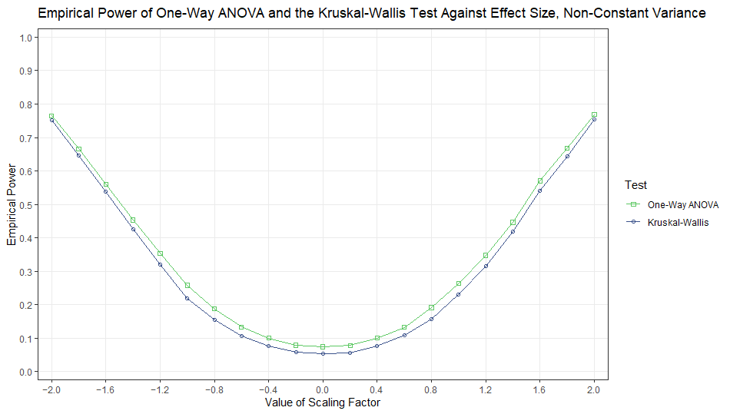

Power With non-Constant Variance
Adjusted Code! ->

Slide 26
What does this mean?
Although both are close, we actually want the Kruskal-Wallis Test!
Alpha level is now higher than usual for one way ANOVA, which means that the Kruskal-Wallis is more robust

Slide 27
Pop Quiz! Which test do you prefer for each scenario?
Normally distributed data with few outliers
Data with many outliers
Data with non-constant variance

Slide 28
Pop Quiz! Which test do you prefer for each scenario?
Normally distributed data with few outliers
One Way ANOVA
Data with many outliers
Kruskal-Wallis
Data with non-constant variance
Kruskal-Wallis (remember type 1 error!)

Slide 29
Final Thoughts
In most of the cases we looked into, ANOVA performed better with the exception of of when we used the Cauchy distribution.
Real life data often has outliers / isn’t perfectly normally distributed
Simulations took fairly long.

Slide 30
Thank You!
Any Questions?

